Slide 1










WE MINIMIZE YOUR EFFORTS
MISSION
GREEN INDIA CLEAN INDIA
CONTACT US :
PHUGE INDUSTRIAL HUB, NEAR MAGZINE CIRCLE, BHOSARI, PUNE - 411039
MOB.NO.: 8308830595/ 9763419537
EMAIL: info@infinitygrp.co.in
WEBSITE : www.infinitygrp.co.in

Slide 2

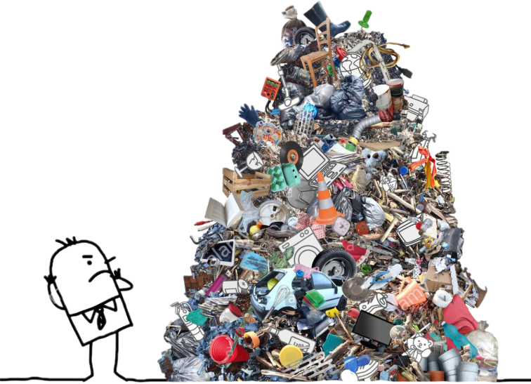




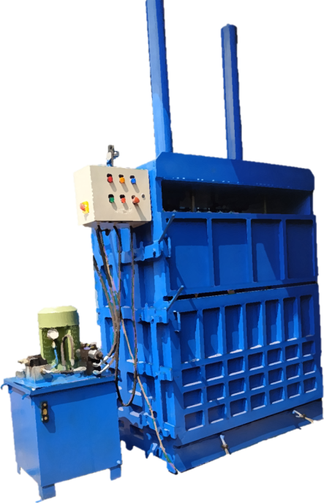
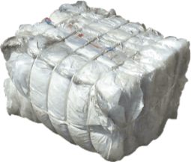
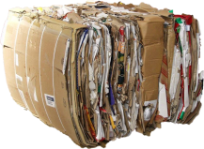
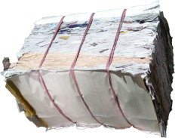
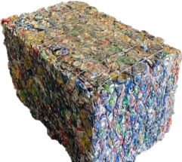
OUR VISION
GROW YOUR BUSUNESS
YOU HAVE A PROBLEM??
THINK INNOVATIVE
REDUCE TRASPORT COST,
SAVE SPACE, EASY HANDLING
COMPACT YOUR WASTE
WE HAVE A SOLUTION!!

Slide 3



Introduction
INFINITY HYDRAULICS uses only the highest quality products available from industry leaders in every HYDRAULIC PRODUCTS application. We are dedicated to being the industry leader in quality with 100% of all HYDRAULICS PRODUCTS tested to full capacity and specifications every time. By using our modular design, they will look and perform the same every time. At INFINITY HYDRAULICS we will always have a prompt and courteous reply to your inquiries. We’ll never promise something we cannot deliver, with our expansive abilities, and over many years of combined technical experience, rest assured we can deliver what you need. We pride ourselves in carefully listening to our customers, to ensure we understand their wants and needs. Exceptional — that’s what we strive for; we want long-term relationships with all of our customers. Just like our first customer who’s been coming back for 24 years, because we do it RIGHT

Slide 4

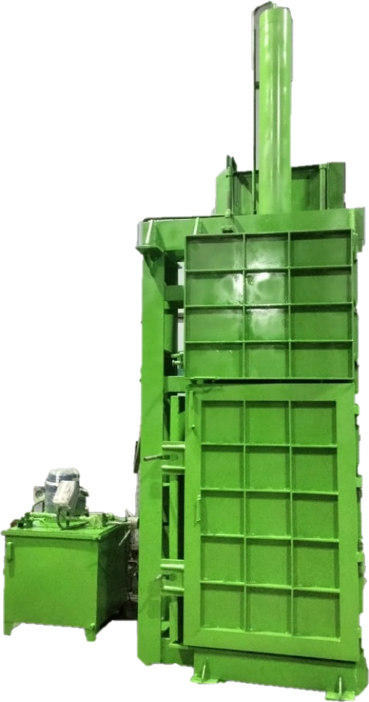
MEGA-1IH7
MEGA-1IH7 is a downstroke vertical baling machine, It can be loaded from both back Side. The machine has a single chamber with double door opening.
This is a Single ram vertical baler and have a compressing force vary from 75 to 100 ton. The different force ratio will depend on what you intend to bale. More force means you can bale harder /larger /stronger material.
MEGA-1IH7 Bales light Non-ferrous!
The INFINITY Model JUMBO-2IH4 bales the following material:
Office paper / Newspaper
Cardboards / OCC
PET bottles
Plastic waste
Aluminium Foil/ Cans
Textiles / Cotton
Packaging Bags
Paddy Straw / Rice Husk
Sugarcane waste
Coconut Coir
MODEL - MEGA - 1IH7
GENERAL SPECIFICATIONS :
CHAMBER SIZE | 900 L X 600 W X 2200 H
BALE SIZE | 900 L X 600 W X 700-1000 H
BALE WEIGHT | 150 - 500 KG
CAPACITY | 75 TON
ELECTRIC MOTOR | 7.5 /10 HP, 3 PHASE
OPERATION | MANUAL/ SEMI AUTOMATIC / FULLY AUTOMATIC
OIL CAPACITY | 400 LTR
MACHINE WEIGHT | 2300 KG (AS SHOWN)

Slide 5
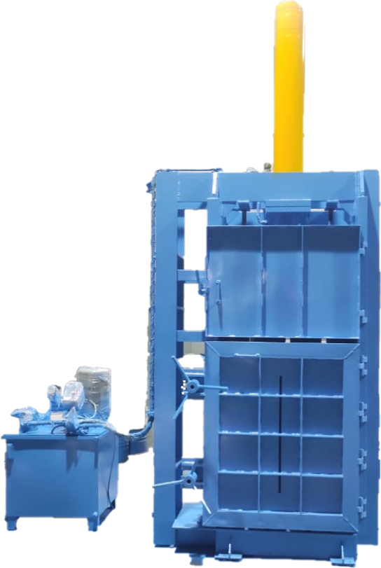
MEGA-1IH6
MEGA-1IH6 is a downstroke vertical baling machine, It can be loaded from both back Side. The machine has a single chamber with double door opening.
This is a Single ram vertical baler and have a compressing force vary from 60 to 80 ton. The different force ratio will depend on what you intend to bale. More force means you can bale harder /larger /stronger material.
MEGA-1IH6 Bales light Non-ferrous!
The INFINITY Model JUMBO-2IH4 bales the following material:
Office paper / Newspaper
Cardboards / OCC
PET bottles
Plastic waste
Aluminium Foil/ Cans
Textiles / Cotton
Packaging Bags
Paddy Straw / Rice Husk
Sugarcane waste
Coconut Coir
MODEL - MEGA - 1IH7
GENERAL SPECIFICATIONS :
CHAMBER SIZE | 900 L X 600 W X 2000 H
BALE SIZE | 900 L X 600 W X 700-900 H
BALE WEIGHT | 150 - 350 KG
CAPACITY | 60 TON
ELECTRIC MOTOR | 7.5 /10 HP, 3 PHASE
OPERATION | MANUAL/ SEMI AUTOMATIC / FULLY AUTOMATIC
OIL CAPACITY | 300 LTR
MACHINE WEIGHT | 2000 KG (AS SHOWN)

Slide 6
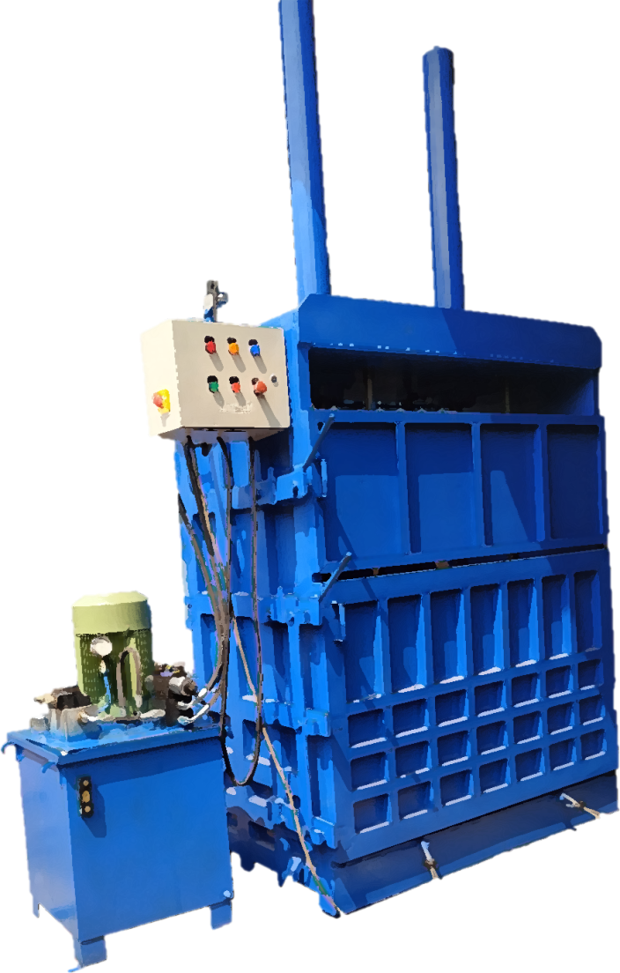




JUMBO-2IH4
JUMBO-2IH4 is a downstroke vertical baling machine, It can be loaded from both front & back Side. The machine has a single chamber with double door opening.
This is a Dual ram vertical baler and have a compressing force vary from 50 to 100 ton. The different force ratio will depend on what you intend to bale. More force means you can bale harder /larger /stronger material.
COLOUR SHADES:
JUMBO-2IH4 Bales light Non-ferrous!
The INFINITY Model JUMBO-2IH4 bales the following material:
Office paper / Newspaper
Cardboards / OCC
PET bottles
Plastic waste
Aluminium Foil/ Cans
Textiles / Cotton
Packaging Bags
Paddy Straw / Rice Husk
Sugarcane waste
Coconut Coir
MODEL - JUMBO - 2IH4
GENERAL SPECIFICATIONS :
CHAMBER SIZE | 1400 L X 800 W X 1300 H
BALE SIZE | 1400 L X 800 W X 300-700 H
BALE WEIGHT | 150 - 350 KG
CAPACITY | 60 TON
ELECTRIC MOTOR | 7.5 /10 HP, 3 PHASE
OPERATION | MANUAL/ SEMI AUTOMATIC / FULLY AUTOMATIC
OIL CAPACITY | 150 LTR
MACHINE WEIGHT | 2000 KG (AS SHOWN)

Slide 7
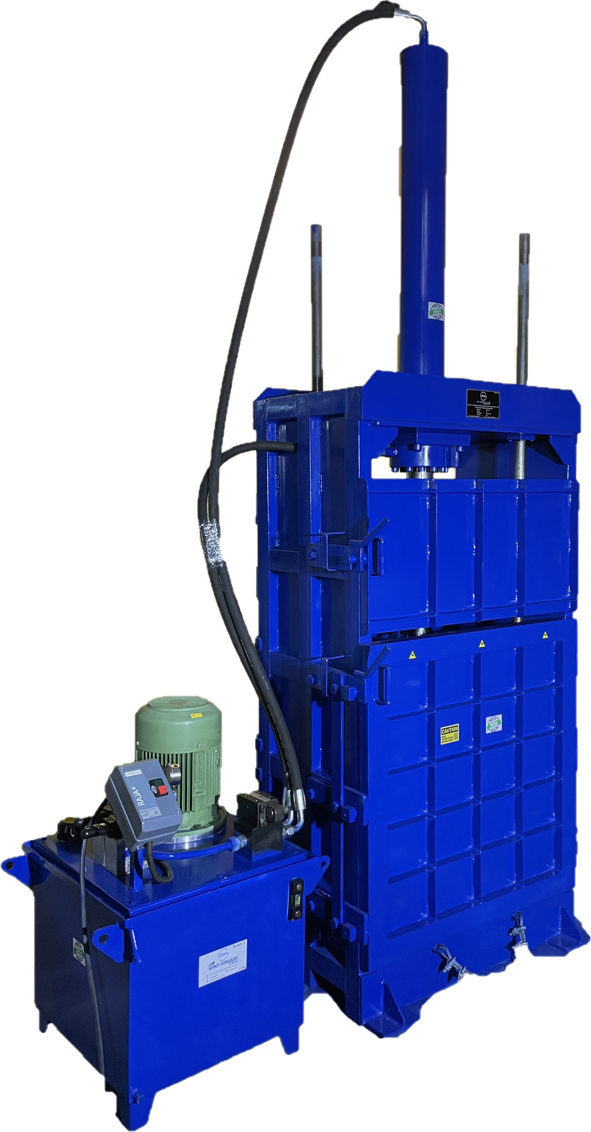
SUMO-1IH6
SUMO-2IH5 is a downstroke vertical baling machine, It can be loaded from front & back Side. The machine has a single chamber with double door opening.
COLOUR SHADES:
This is a single ram vertical baler and have a compressing force vary from 50 to 75 ton. The different force ratio will depend on what you intend to bale. More force means you can bale harder /larger /stronger material.
SUMO-1HI5 Bales light Non-ferrous!
The INFINITY Model SUMO-1IH5 bales the following material:
Office paper / Newspaper
Cardboards / OCC
PET bottles
Plastic waste
Aluminium Foil/ Cans
Textiles / Cotton
Packaging Bags
Paddy Straw / Rice Husk
Sugarcane waste
Coconut Coir
MODEL : SUMO-1IH6
GENERAL SPECIFICATIONS :
CHAMBER SIZE | 900 L X 600 W X 1300 H
BALE SIZE | 900 L X 600 W X 300-700 H
BALE WEIGHT | 100-250 KG
CAPACITY | 50 TO 75 TON
ELECTRIC MOTOR | 5 HP / 7.5 HP / 10 HP 3 PHASE
OPERATION | MANUAL/ SEMI AUTOMATIC / FULLY AUTOMATIC
OIL CAPACITY | 150 LTR
MACHINE WEIGHT | 1500 KG (AS SHOWN)

Slide 8
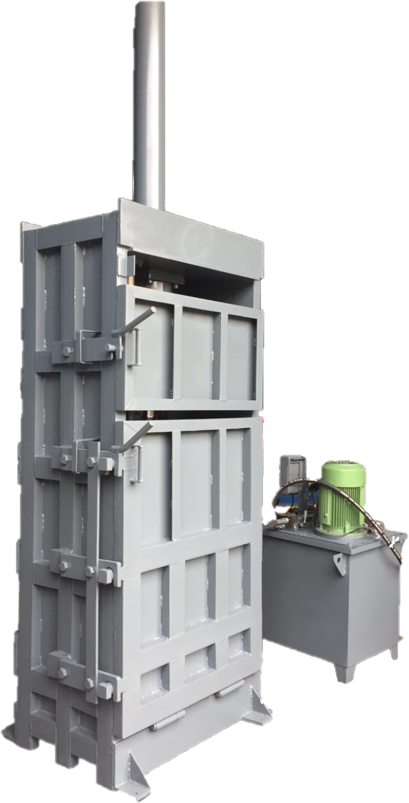
GRAM-1IH4
GRAM-1IH5 is specially designed as per Grampanchayat requirement. It is a downstroke vertical baling machine, It can be loaded from front & back Side. The machine has a single chamber with double door opening.
This is a single ram vertical baler and have a compressing force vary from 25 to 50 ton. The different force ratio will depend on what you intend to bale. More force means you can bale harder /larger /stronger material.
COLOUR SHADES:
GRAM-1HI5 Bales light Non-ferrous!
The INFINITY Model GRAM-1IH5 bales the following material:
Office paper / Newspaper
Cardboards / OCC
PET bottles
Plastic waste
Aluminium Foil/ Cans
Textiles / Cotton
Packaging Bags
Paddy Straw / Rice Husk
Sugarcane waste
Coconut Coir
MODEL : GRAM-1IH5
GENERAL SPECIFICATIONS :
CHAMBER SIZE | 700 L X 500 W X 1300 H
BALE SIZE | 700 L X 500 W X 300-700 H
BALE WEIGHT | 50 - 150 KG
CAPACITY | 25 TO 50 TON
ELECTRIC MOTOR | 5 HP / 7.5 HP THREE PHASE
OPERATION | MANUAL/ SEMI AUTOMATIC / FULLY AUTOMATIC
OIL CAPACITY | 120 to 150 LTR
MACHINE WEIGHT | 1100 KG (AS SHOWN)

Slide 9
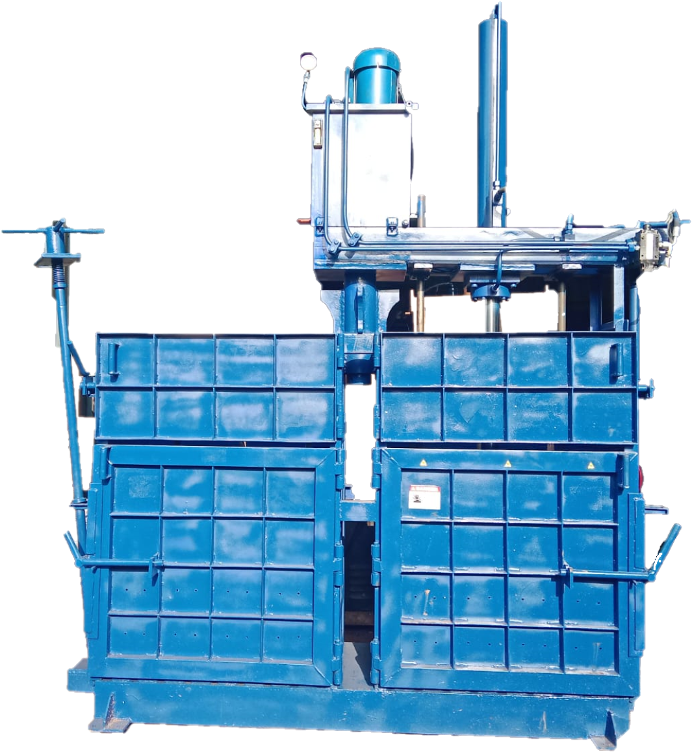
DC-1IH4
DC-1IH4 has a double chamber with single Cylinder. It is a downstroke vertical baling machine, It can be loaded from Top Side. The machine has a two chambers with double door opening.
This is a single ram vertical baler and have a compressing force vary from 25 to 50 ton. The different force ratio will depend on what you intend to bale. More force means you can bale harder /larger /stronger material.
DOUBLE CHAMBER MACHINES ARE AVAILABLE IN ALL CHAMBER SIZES
COLOUR SHADES:
DC-1HI4 Bales light Non-ferrous!
The INFINITY Model DC-1IH5 bales the following material:
Office paper / Newspaper
Cardboards / OCC
PET bottles
Plastic waste
Aluminium Foil/ Cans
Textiles / Cotton
Packaging Bags
Paddy Straw / Rice Husk
Sugarcane waste
Coconut Coir
MODEL : DC-1IH4
GENERAL SPECIFICATIONS :
CHAMBER SIZE | 900 L X 600 W X 1300 H
BALE SIZE | 700 L X 500 W X 300-700 H
BALE WEIGHT | 50 - 150 KG (For one Chamber)
CAPACITY | 25 TO 50 TON
ELECTRIC MOTOR | 5 HP / 7.5 HP THREE PHASE
OPERATION | MANUAL/ SEMI AUTOMATIC / FULLY AUTOMATIC
OIL CAPACITY | 150 LTR
MACHINE WEIGHT | 1600 KG (AS SHOWN)

Slide 10
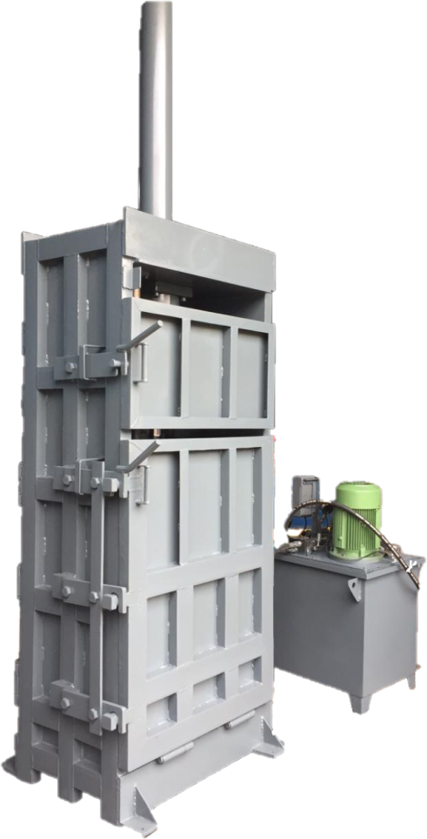
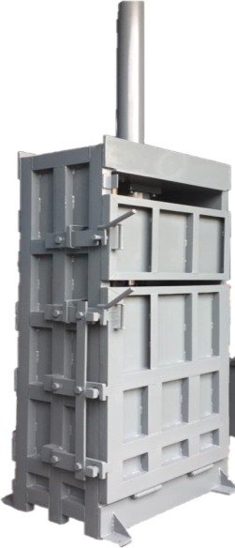
DC-1IH5
DC-1IH5 has a double chamber with single power pack. It is a downstroke vertical baling machine, It can be loaded from both front & back Side. The machine has a two chambers with double door opening.
This is a single ram vertical baler and have a compressing force vary from 25 to 50 ton. The different force ratio will depend on what you intend to bale. More force means you can bale harder /larger /stronger material.
DOUBLE CHAMBER MACHINES ARE AVAILABLE IN ALL CHAMBER SIZES
COLOUR SHADES:
DC-1HI5 Bales light Non-ferrous!
The INFINITY Model DC-1IH5 bales the following material:
Office paper / Newspaper
Cardboards / OCC
PET bottles
Plastic waste
Aluminium Foil/ Cans
Textiles / Cotton
Packaging Bags
Paddy Straw / Rice Husk
Sugarcane waste
Coconut Coir
MODEL : DC-1IH5
GENERAL SPECIFICATIONS :
CHAMBER SIZE | 700 L X 500 W X 1300 H
BALE SIZE | 700 L X 500 W X 300-700 H
BALE WEIGHT | 50 - 150 KG (For one Chamber)
CAPACITY | 25 TO 50 TON
ELECTRIC MOTOR | 5 HP / 7.5 HP THREE PHASE
OPERATION | MANUAL/ SEMI AUTOMATIC / FULLY AUTOMATIC
OIL CAPACITY | 150 LTR
MACHINE WEIGHT | 1100 KG (AS SHOWN)

Slide 11
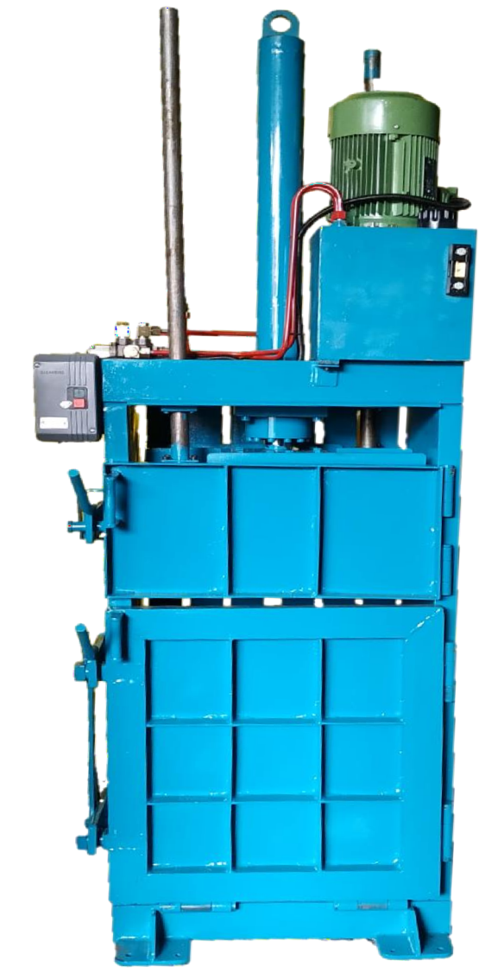
MINI-1IH3
MINI-1IH3 is a downstroke vertical baling machine, It can be loaded from front & back Side. The machine has a single chamber with double door opening.
COLOUR SHADES:
This is a single ram vertical baler and have a compressing force vary from 10 to 25 ton. The different force ratio will depend on what you intend to bale. More force means you can bale harder /larger /stronger material.
MINI-1IH3 Bales light Non-ferrous!
The INFINITY Model GRAM-1IH3 bales the following material:
Office paper / Newspaper
Cardboards / OCC
PET bottles
Plastic waste
Aluminium Foil/ Cans
Textiles / Cotton
Packaging Bags
Paddy Straw / Rice Husk
Sugarcane waste
Coconut Coir
MODEL : MINI-1IH3
GENERAL SPECIFICATIONS :
CHAMBER SIZE | 600 L X 400 W X 1000 H
BALE SIZE | 600 L X 400 W X 300-500 H
BALE WEIGHT | 20 to 50 KG
CAPACITY | 10 to 25 TON
ELECTRIC MOTOR | 3 HP THREE PHASE
OPERATION | MANUAL/ SEMI AUTOMATIC / FULLY AUTOMATIC
OIL CAPACITY | Upto 75 LTR
MACHINE WEIGHT | 800 KG (AS SHOWN)

Slide 12





















OUR CLIENTS
HERE SOME OUR VALUABLE COUSTOMERS
AND MORE THAN 550’S OF HAPPIEST AND SATISFIED CUSTOMER

